Slide 1
Map layout
Geomathematics, programming and geoinformatics
2026.03.11.
Ákos Bede-Fazekas

Slide 2
Print layout, map composition interface

Slide 3
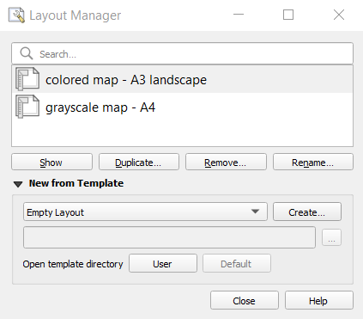
Print layouts
Project > Layout Manager…
  open previously created layouts
  create a new one
Notes:
Projekt > Elrendezéskezelő…

Slide 4
Print layouts
Project > Layout Manager…
  open previously created layouts
  create a new one

Slide 5
Print layouts
Project > Layout Manager…
  open previously created layouts
  create a new one

Slide 6
Print layouts
Project > Layout Manager…
  open previously created layouts
  create a new one
DEMO
  create a new print layout

Slide 7
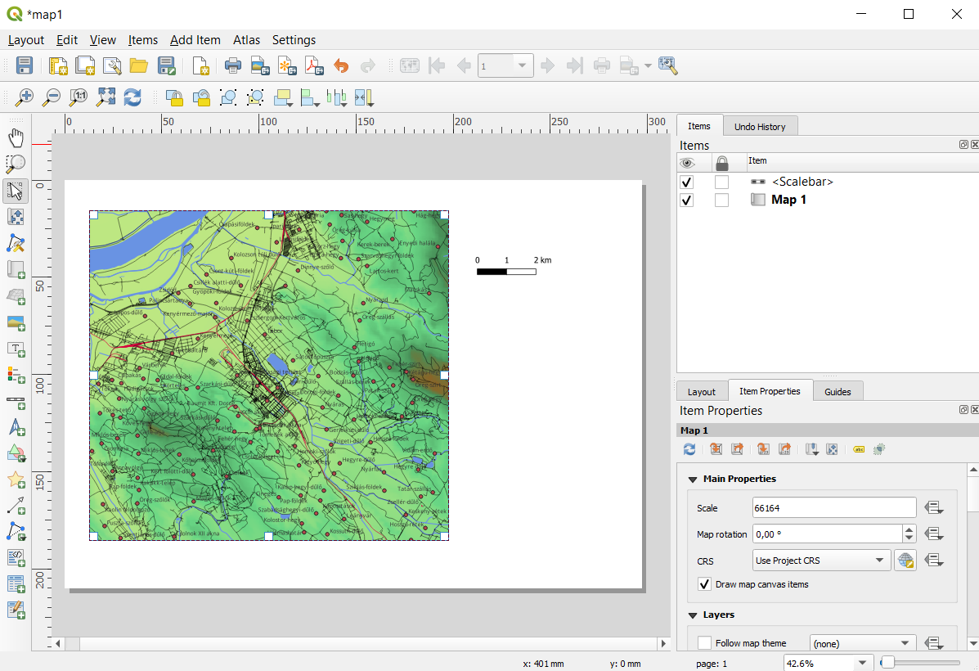
Map composition interface
add new item
overview of existing items
customize the selected item
navigation and selection
export
aligning and grouping items

Slide 8
Map composition interface
add new item
overview of existing items
customize the selected item
navigation and selection
export
aligning and grouping items

Slide 9
Map composition interface
add new item
overview of existing items
customize the selected item
navigation and selection
export
aligning and grouping items

Slide 10
Map composition interface
add new item
overview of existing items
customize the selected item
navigation and selection
export
aligning and grouping items

Slide 11
Map composition interface
add new item
overview of existing items
customize the selected item
navigation and selection
export
aligning and grouping items

Slide 12
Map composition interface
add new item
overview of existing items
customize the selected item
navigation and selection
export
aligning and grouping items

Slide 13
Map composition interface
add new item
overview of existing items
customize the selected item
navigation and selection
export
aligning and grouping items

Slide 14
Map composition interface
add new item
overview of existing items
customize the selected item
navigation and selection
export
aligning and grouping items
and of course the most important:
  the print layout

Slide 15
Map composition interface
DEMO
  add a map and a scale bar to the print layout
  select the map to view the item properties

Slide 16
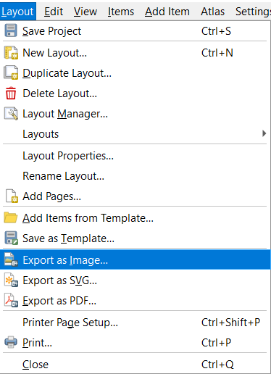
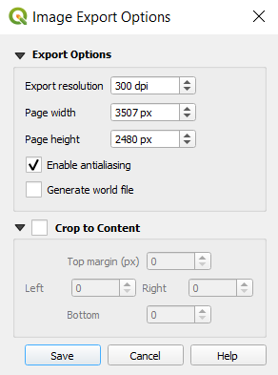
Exporting the map
the map can be sent to the printer
or saved as
  raster image (PNG, JPG, TIF, BMP etc.)
  vector graphic (SVG)
  PDF document
available from the menu or the toolbar

Slide 17
Exporting the map
the map can be sent to the printer
or saved as
  raster image (PNG, JPG, TIF, BMP etc.)
  vector graphic (SVG)
  PDF document
available from the menu or the toolbar

Slide 18
Exporting the map
the map can be sent to the printer
or saved as
  raster image (PNG, JPG, TIF, BMP etc.)
  vector graphic (SVG)
  PDF document
available from the menu or the toolbar

Slide 19
Exporting the map
the map can be sent to the printer
or saved as
  raster image (PNG, JPG, TIF, BMP etc.)
  vector graphic (SVG)
  PDF document
available from the menu or the toolbar
DEMO
  save it as a PNG image
  with 600 dpi resolution

Slide 20
Saving the print layout
do not forget to save the project occasionally
  and thus also the print layout
DEMO
  save

Slide 21
Layout items

Slide 22
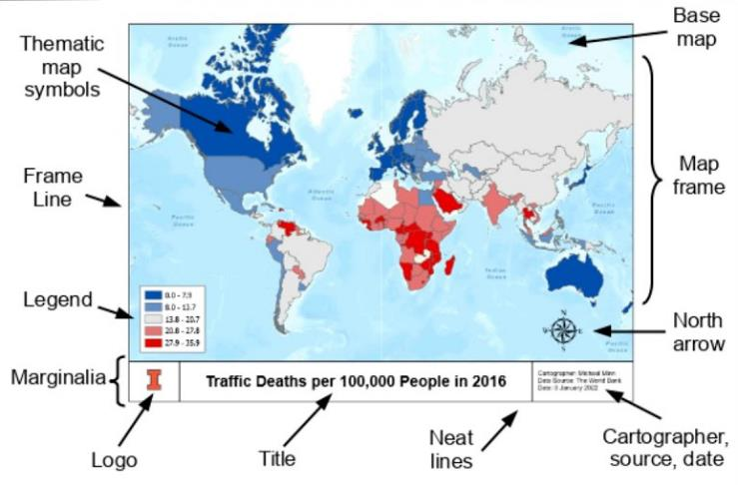

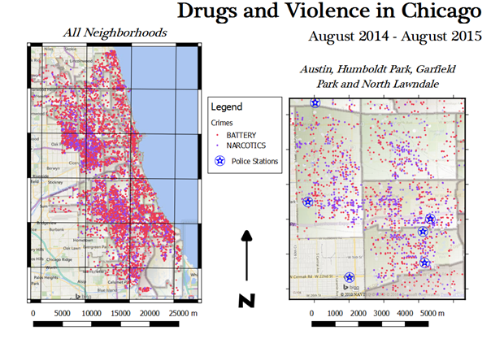
Layout items
map
3D Map
picture: simple image
label: text box, e.g. for a title
legend
scale bar
north arrow
Notes:
térkép
3D térkép
kép
címke
jelmagyarázat
lépték
északjel

Slide 23
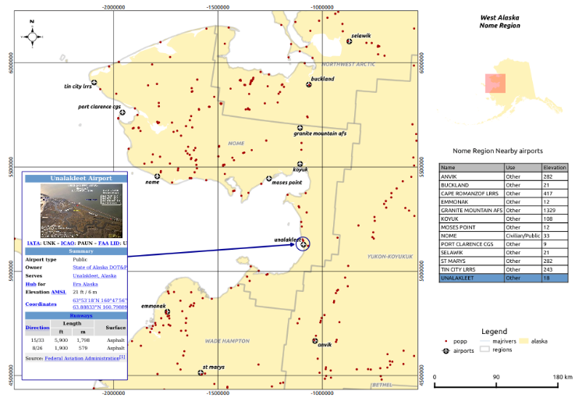

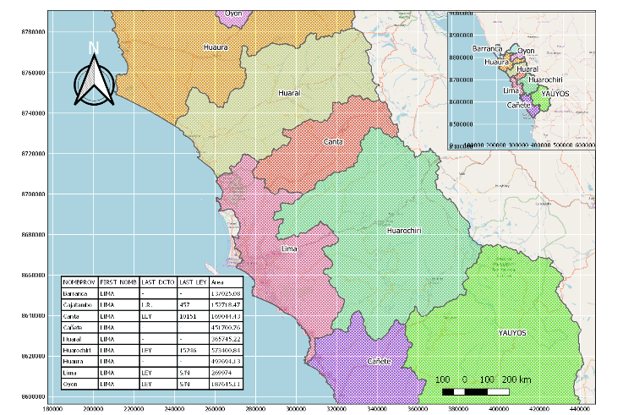
Layout items
shape: rectangle/ellipse/triangle
marker: point symbol
arrow
node item: polygon or polyline
HTML: formatted text
attribute table
fixed table: simple table
Notes:
alak
szimbólum
nyíl
csomópont elem
HTML
attribútumtábla
fix táblázat

Slide 24
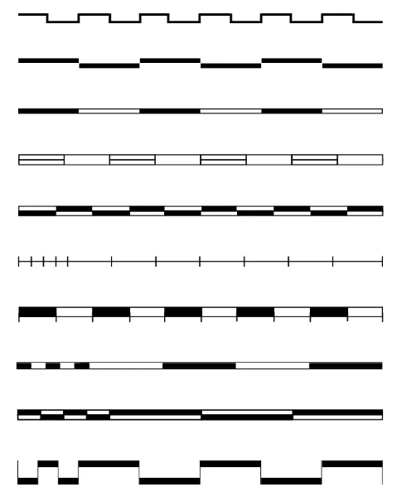
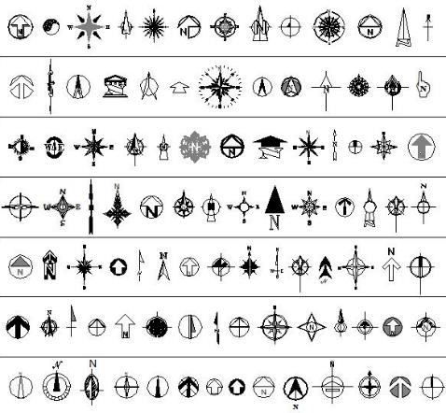
North arrow, scale bar
common properties of the scale bar and north arrow
  linked map
  size
  background, frame, position
  name
additional properties of the scale bar
  style (ticks, black–white rectangles, stepped etc.)
  unit
  segments
additional properties of the north arrow
  shape (raster image or SVG)

Slide 25
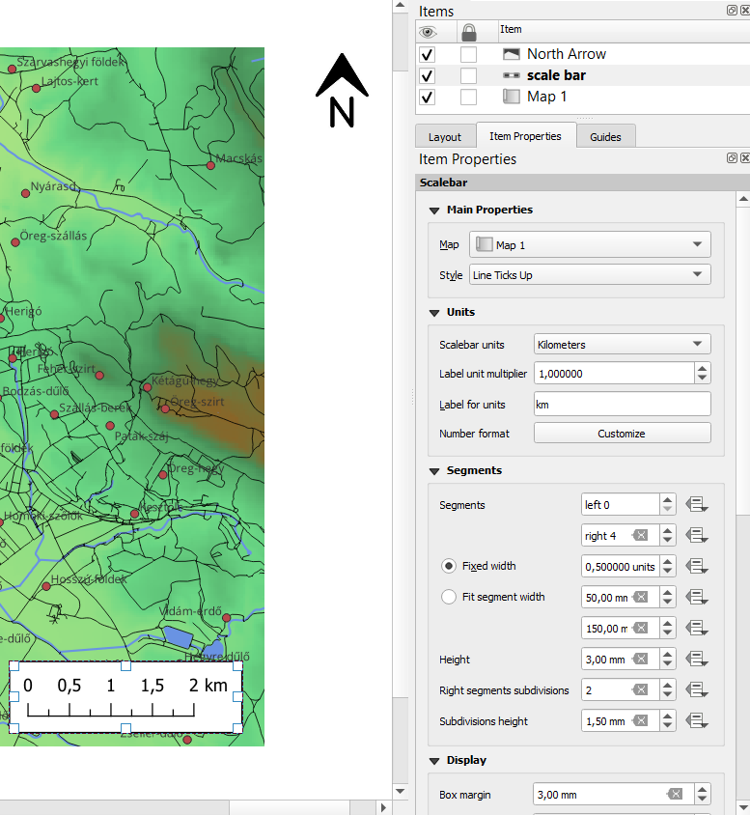
North arrow, scale bar
DEMO
  add a white background (Background) and a black frame (Frame) to the scale bar
  increase the margin to 3 mm (Display)
  rename it to "scale bar" (Items)
  set the unit to km (Units)
  construct it from four main segments of 0.5 km with subdivisions between them (Segments), using the "Line Ticks Up" style (Main Properties)
Notes:
Térképtippek

Slide 26
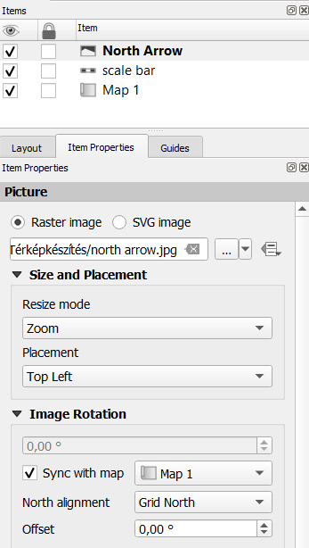
North arrow, scale bar
DEMO
  add a north arrow to the layout
  as the symbol, select the raster image north arrow.jpg
  make sure it is also linked to our map (Image Rotation)
Notes:
Térképtippek

Slide 27
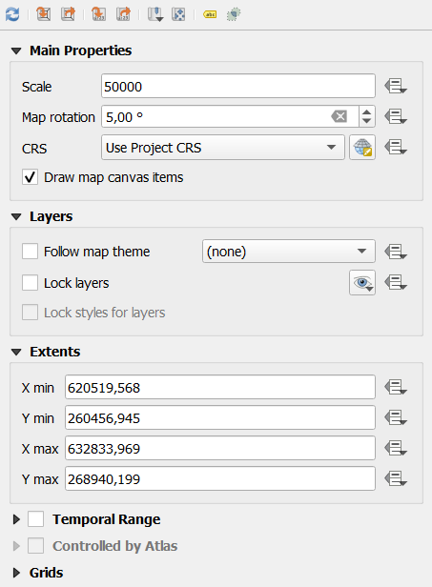
Map
main buttons
  refresh
  copy extent/scale from or to the editing interface ("Main Canvas")
  "Interactively Edit Map Extent": zoom enabled
main properties
  scale and rotation
  lock layer visibility and style (no further synchronization)
  extent
  grid, frame and coordinate annotations
Notes:
"fő vászon"
"térképterjedelem interaktív szerkesztése"

Slide 28
Map
main buttons
  refresh
  copy extent/scale from or to the editing interface ("Main Canvas")
  "Interactively Edit Map Extent": zoom enabled
main properties
  scale and rotation
  lock layer visibility and style (no further synchronization)
  extent
  grid, frame and coordinate annotations
Notes:
"fő vászon"
"térképterjedelem interaktív szerkesztése"

Slide 29
Map
main buttons
  refresh
  copy extent/scale from or to the editing interface ("Main Canvas")
  "Interactively Edit Map Extent": zoom enabled
main properties
  scale and rotation
  lock layer visibility and style (no further synchronization)
  extent
  grid, frame and coordinate annotations
Notes:
"fő vászon"
"térképterjedelem interaktív szerkesztése"

Slide 30
Map
main buttons
  refresh
  copy extent/scale from or to the editing interface ("Main Canvas")
  "Interactively Edit Map Extent": zoom enabled
main properties
  scale and rotation
  lock layer visibility and style (no further synchronization)
  extent
  grid, frame and coordinate annotations
Notes:
"fő vászon"
"térképterjedelem interaktív szerkesztése"

Slide 31
Map
main buttons
  refresh
  copy extent/scale from or to the editing interface ("Main Canvas")
  "Interactively Edit Map Extent": zoom enabled
main properties
  scale and rotation
  lock layer visibility and style (no further synchronization)
  extent
  grid, frame and coordinate annotations
Notes:
"fő vászon"
"térképterjedelem interaktív szerkesztése"

Slide 32
Map
main buttons
  refresh
  copy extent/scale from or to the editing interface ("Main Canvas")
  "Interactively Edit Map Extent": zoom enabled
main properties
  scale and rotation
  lock layer visibility and style (no further synchronization)
  extent
  grid, frame and coordinate annotations
Notes:
"fő vászon"
"térképterjedelem interaktív szerkesztése"

Slide 33
Map
main buttons
  refresh
  copy extent/scale from or to the editing interface ("Main Canvas")
  "Interactively Edit Map Extent": zoom enabled
main properties
  scale and rotation
  lock layer visibility and style (no further synchronization)
  extent
  grid, frame and coordinate annotations
Notes:
"fő vászon"
"térképterjedelem interaktív szerkesztése"

Slide 34
Map
main buttons
  refresh
  copy extent/scale from or to the editing interface ("Main Canvas")
  "Interactively Edit Map Extent": zoom enabled
main properties
  scale and rotation
  lock layer visibility and style (no further synchronization)
  extent
  grid, frame and coordinate annotations
Notes:
"fő vászon"
"térképterjedelem interaktív szerkesztése"

Slide 35
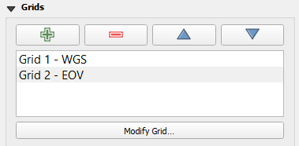
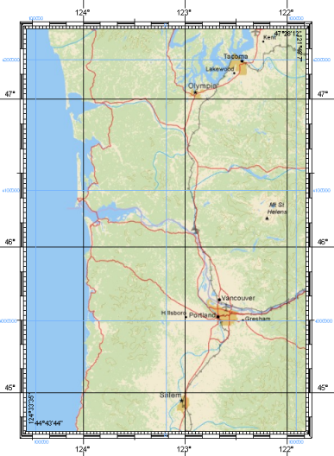
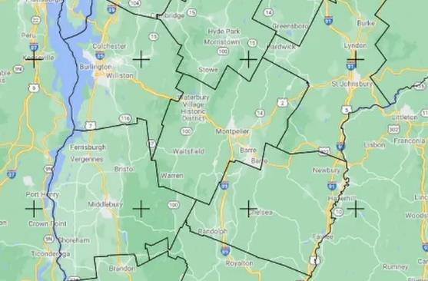
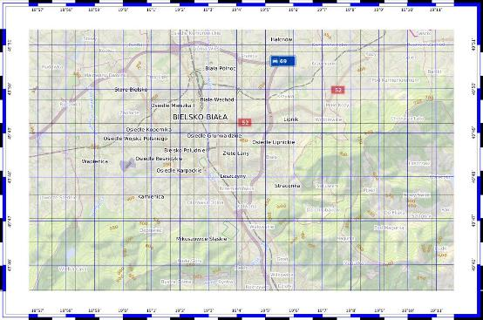
Map – grid, frame and coordinates
multiple grids can be defined
  e.g. main and secondary grid (thick + thin)
  or according to different coordinate systems (WGS-84 and national)
the "grid" consists of three components (these can be switched on/off independently):
  grid or crosses
  frame ("zebra", line with ticks, simple line)
  coordinate annotations
Notes:
"rács"

Slide 36
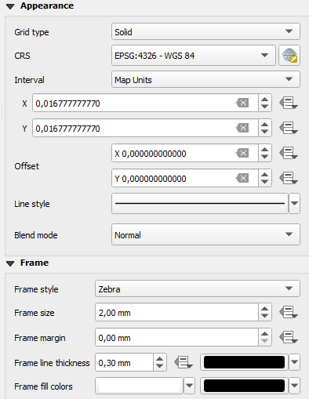

Map – grid, frame and coordinates
grid properties
  type
  coordinate reference system
  interval and its unit
  style
frame properties
  type ("zebra", line with ticks, simple line)
  style settings
coordinate annotation properties
  format: decimal, DM, DMS; with or without suffix
  per side: display or not, outside/inside, rotation
  number of decimal places

Slide 37
Map – grid, frame and coordinates
grid properties
  type
  coordinate reference system
  interval and its unit
  style
frame properties
  type ("zebra", line with ticks, simple line)
  style settings
coordinate annotation properties
  format: decimal, DM, DMS; with or without suffix
  per side: display or not, outside/inside, rotation
  number of decimal places

Slide 38
Map – grid, frame and coordinates
grid properties
  type
  coordinate reference system
  interval and its unit
  style
frame properties
  type ("zebra", line with ticks, simple line)
  style settings
coordinate annotation properties
  format: decimal, DM, DMS; with or without suffix
  per side: display or not, outside/inside, rotation
  number of decimal places

Slide 39
Map – grid, frame and coordinates
grid properties
  type
  coordinate reference system
  interval and its unit
  style
frame properties
  type ("zebra", line with ticks, simple line)
  style settings
coordinate annotation properties
  format: decimal, DM, DMS; with or without suffix
  per side: display or not, outside/inside, rotation
  number of decimal places

Slide 40
Map – grid, frame and coordinates
grid properties
  type
  coordinate reference system
  interval and its unit
  style
frame properties
  type ("zebra", line with ticks, simple line)
  style settings
coordinate annotation properties
  format: decimal, DM, DMS; with or without suffix
  per side: display or not, outside/inside, rotation
  number of decimal places

Slide 41
Map – grid, frame and coordinates
grid properties
  type
  coordinate reference system
  interval and its unit
  style
frame properties
  type ("zebra", line with ticks, simple line)
  style settings
coordinate annotation properties
  format: decimal, DM, DMS; with or without suffix
  per side: display or not, outside/inside, rotation
  number of decimal places

Slide 42
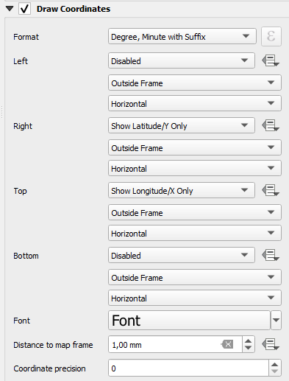
Map – grid, frame and coordinates
grid properties
  type
  coordinate reference system
  interval and its unit
  style
frame properties
  type ("zebra", line with ticks, simple line)
  style settings
coordinate annotation properties
  format: decimal, DM, DMS; with or without suffix
  per side: display or not, outside/inside, rotation
  number of decimal places

Slide 43
Map – grid, frame and coordinates
grid properties
  type
  coordinate reference system
  interval and its unit
  style
frame properties
  type ("zebra", line with ticks, simple line)
  style settings
coordinate annotation properties
  format: decimal, DM, DMS; with or without suffix
  per side: display or not, outside/inside, rotation
  number of decimal places

Slide 44
Map – grid, frame and coordinates
grid properties
  type
  coordinate reference system
  interval and its unit
  style
frame properties
  type ("zebra", line with ticks, simple line)
  style settings
coordinate annotation properties
  format: decimal, DM, DMS; with or without suffix
  per side: display or not, outside/inside, rotation
  number of decimal places

Slide 45
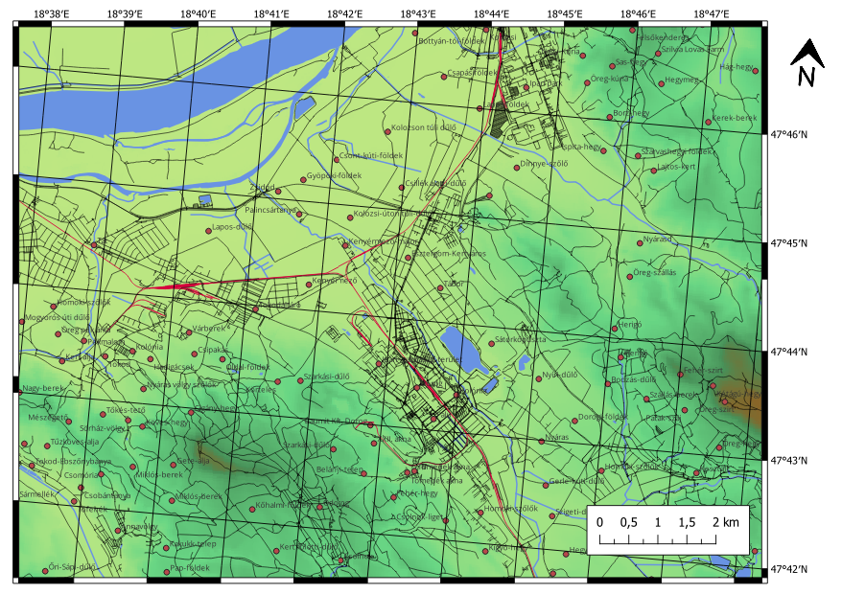
Map
DEMO
  create this map (►)
  the scale should be M 1:50 000
  apply a rotation of 5°
  add a WGS-84 coordinate grid with an interval of 0.0166666667° (1′)
  use a zebra-type frame
  display coordinate annotations at the top and on the right side with suffix, in DM format as integers

Slide 46
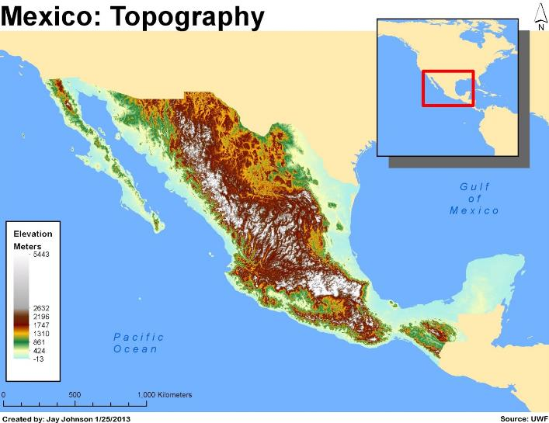
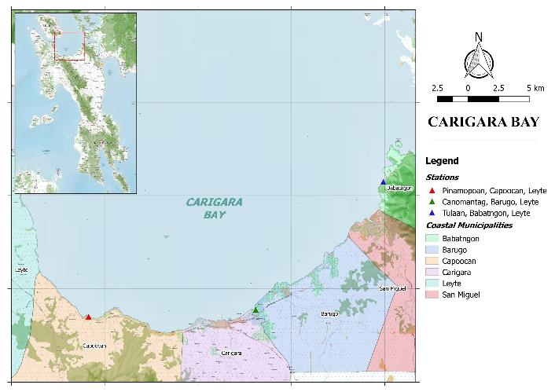
Adding an inset map
a print layout may contain multiple maps
  typically complemented with a small overview inset map
  where the area shown on the main map is indicated with a rectangle
  for this, layers are usually shown or hidden depending on scale

Slide 47
Adding an inset map
a print layout may contain multiple maps
  typically complemented with a small overview inset map
  where the area shown on the main map is indicated with a rectangle
  for this, layers are usually shown or hidden depending on scale
– COMING SOON –

Slide 48
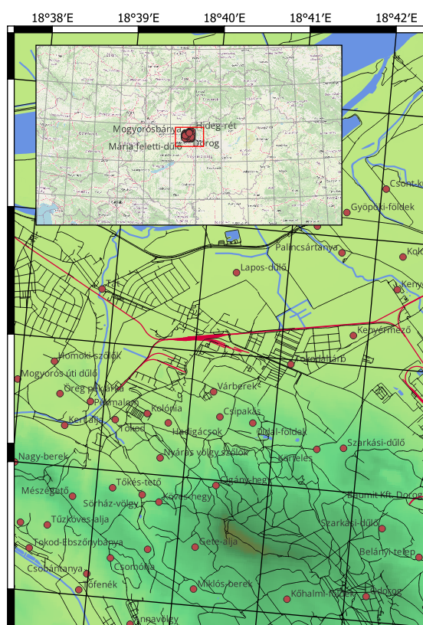
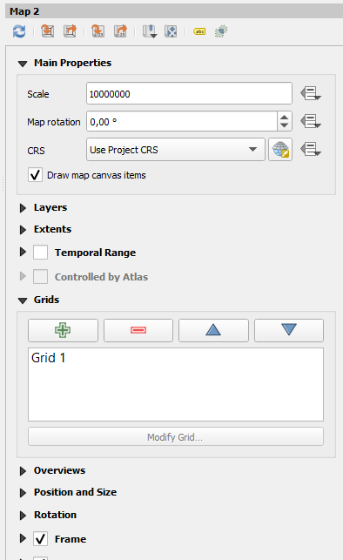


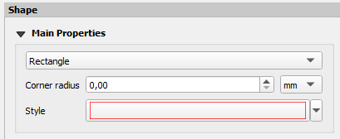
Adding an inset map
DEMO
  add an inset map to the upper left corner of our map with a black frame
  showing the Carpathian Basin at a scale of M 1:10 000 000
  display a thin grey grid with 1° interval and a simple frame
  and add a rectangle with a red outline

Slide 49
Adding an inset map
DEMO
  add an inset map to the upper left corner of our map with a black frame
  showing the Carpathian Basin at a scale of M 1:10 000 000
  display a thin grey grid with 1° interval and a simple frame
  and add a rectangle with a red outline
– U G L Y ! –

Slide 50
Adding an inset map
DEMO
  add an inset map to the upper left corner of our map with a black frame
  showing the Carpathian Basin at a scale of M 1:10 000 000
  display a thin grey grid with 1° interval and a simple frame
  and add a rectangle with a red outline
– U G L Y ! –
– R E C T A N G L E I N W R O N G P L A C E –

Slide 51
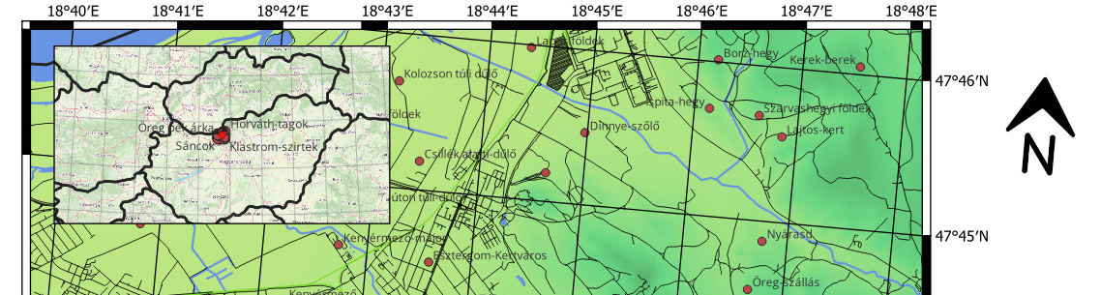
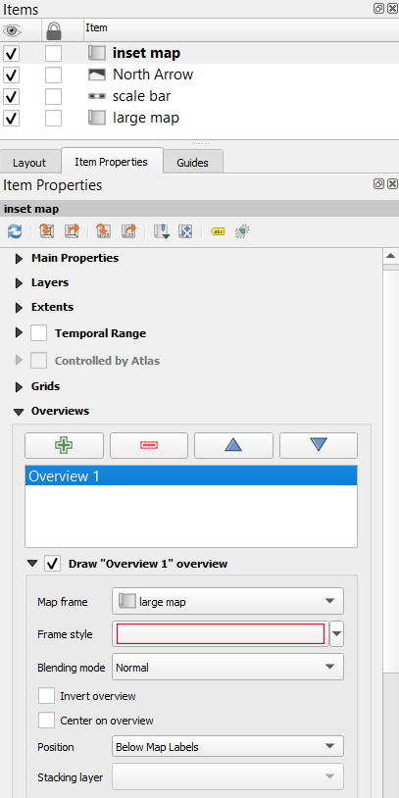
Marking the mapped area with a rectangle
DEMO
  delete the rectangle, then load the countries.gpkg file
  display it without fill, with a thick (0.6 mm) black outline
  give meaningful names to our two maps (e.g. large map, inset map)
  add an "overview" to the inset map that shows the position of the large map without fill and with a red outline
Notes:
"áttekintő"

Slide 52
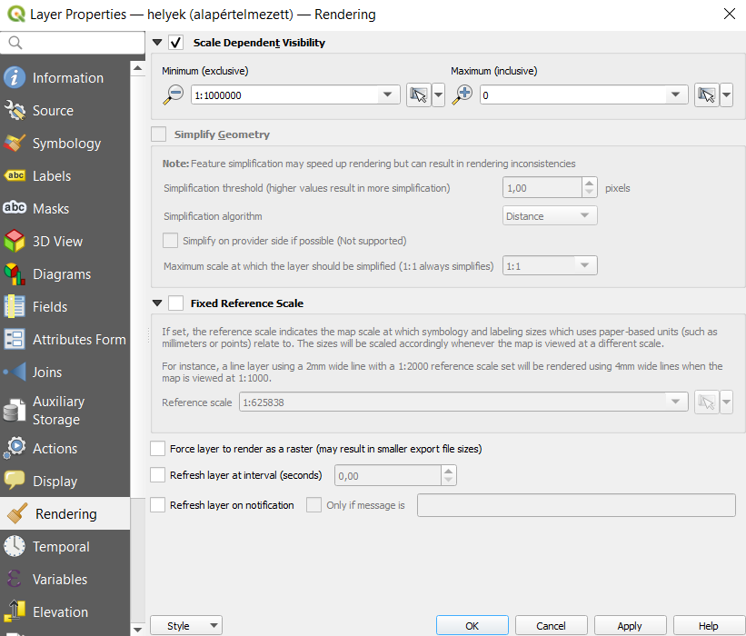
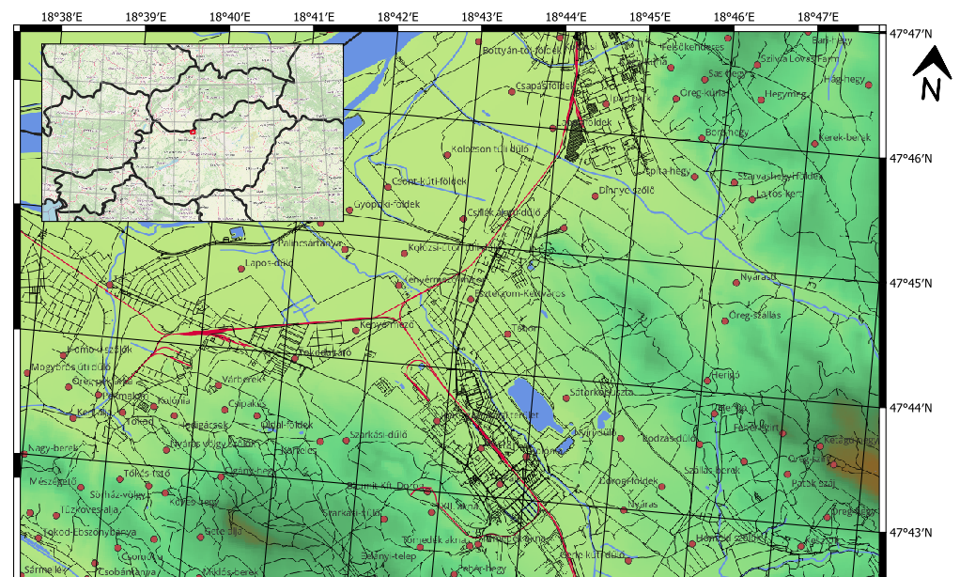
Scale-dependent rendering
DEMO
  open the properties of the places layer
  in the Rendering section enable scale dependent visibility
  display it only on maps more detailed than
  M 1:1 000 000
  check by zooming
  copy this style element to all other vector layers except countries
  (right click > Styles > Copy/Paste Style > Rendering)
  set the same for the digital elevation model
  refresh the maps
Notes:
Megjelenítés
jobb klikk > Stílus > Stílus másolása/beillesztése > Megjelenítés

Slide 53
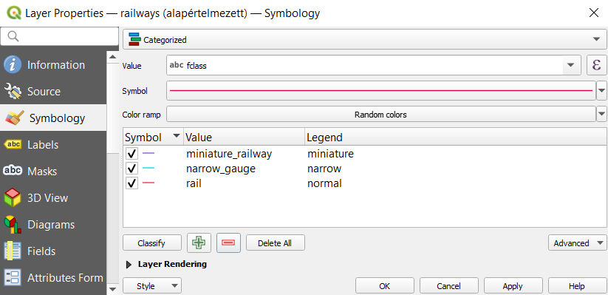
Legend
DEMO
  color the railways layer based on the fclass field
  give meaningful names to the three types
  delete the other type

Slide 54
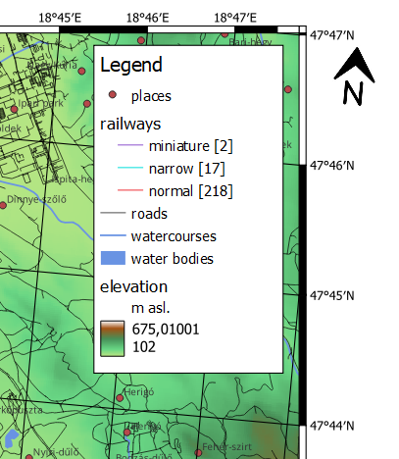
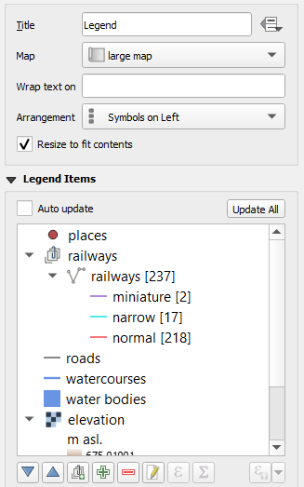

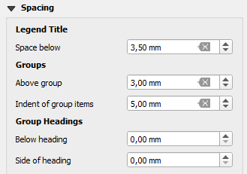
Legend
DEMO
  add a legend to the print layout with
  a frame and title
  remove the countries and the base
  map from the legend
  rename the single layer of the
  elevation model to "m asl."
  create a group named "railways"
  place the railways layer in it, set it to not visible (right click > Hidden), and display feature counts
  move it before roads
  then add indentation to the group items (Spacing section)

Slide 55
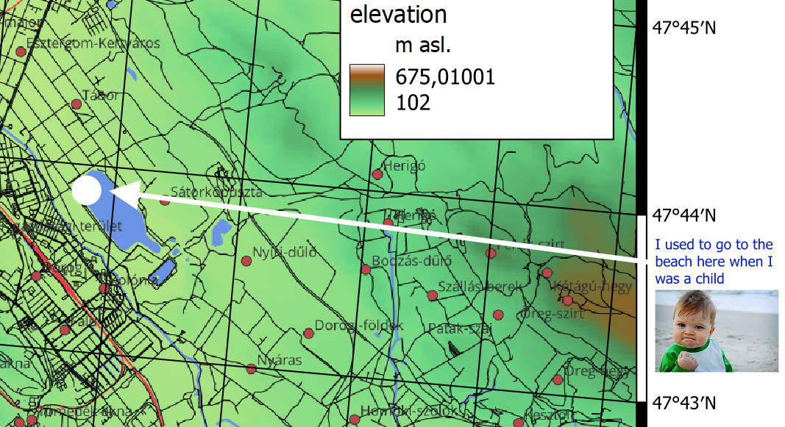



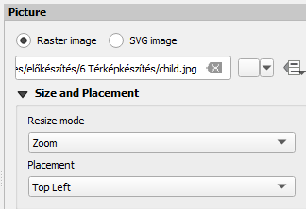
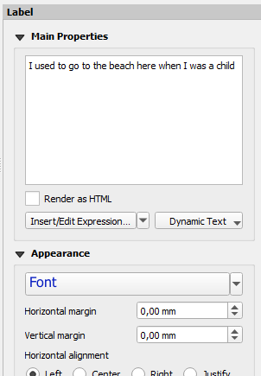
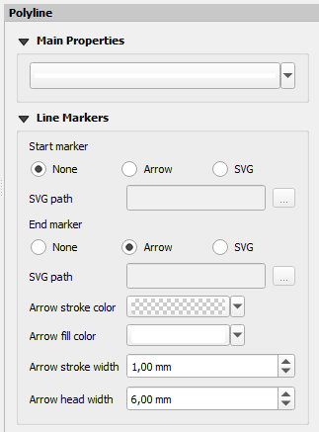

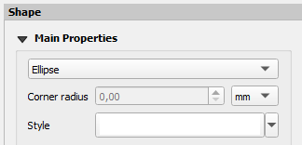
Adding other items
DEMO
  add a white-filled circle (ellipse + Shift) without outline at an arbitrary point of the map
  place a raster image file (in the example: child.jpg) in the map margin
  add a text label in a color different from black
  draw a white arrow from the text to the circle

Slide 56
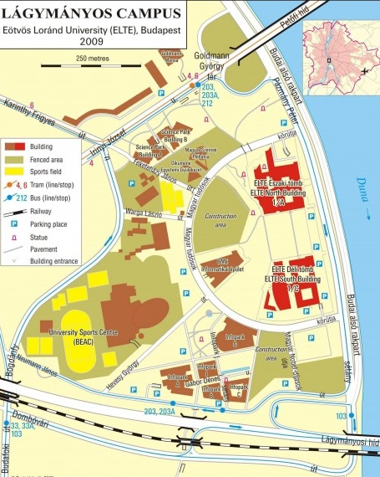
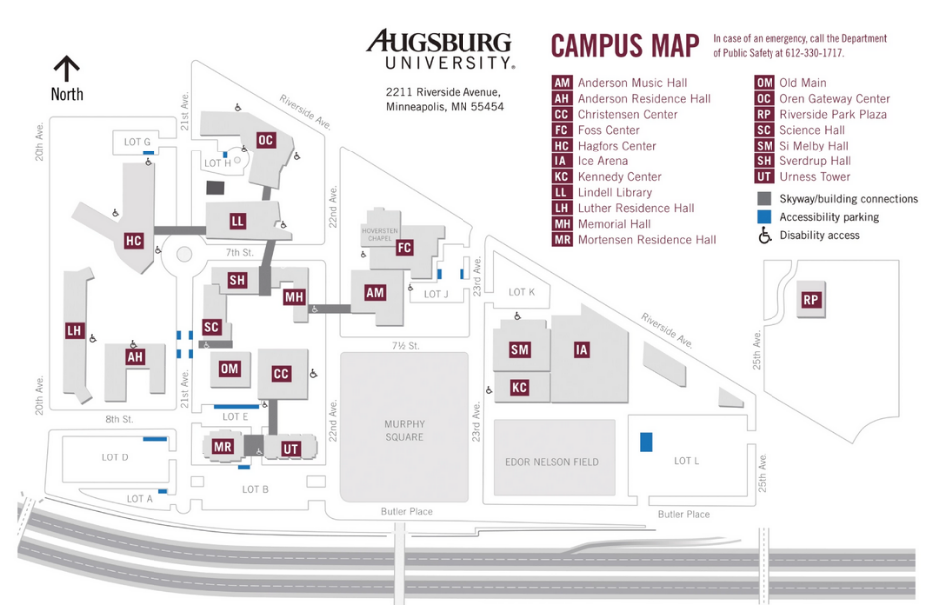
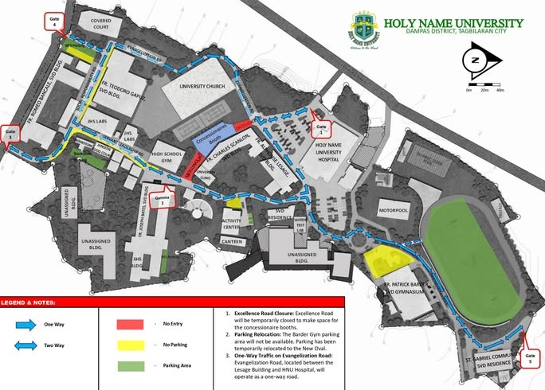
Adding other items
of course in practice we usually add
  the map title
  the author’s name
  and an institutional logo

Slide 57
Thank you for your attention!
questions?

